Slide 1

PROJECT WORK
Effect of Crime on the Housing Market in the Houston Metro-Area
Prepared by Andres, Christy, Radhika, Samuel, Zhanna
Notes:
The largest and most important purchase that a consumer will make in his lifetime is a house. A lot of time and energy goes into determining exactly what one wants in a new home. The buyer must figure out their preferences regarding the location of the house, including the city, neighborhood, and proximity to certain amenities and general aesthetic style. Significant amount of attention is drawn into crime, school and life quality. Theoretically, homebuyers would pay a premium in order to live in a physically safe environment to avoid crime, as well as the mental security of knowing that they are safe.

Slide 2
PROJECT DESCRIPTION
This project is intended to be used as baseline for understanding the housing market economy and the impact of crime on property values across the Houston metropolitan area by population.
We have therefore chosen these major cities for our analysis:
Baytown
Friendswood
Galveston
Houston
La Porte
League City
Missouri City
Pasadena
Sugar Land
Texas City

Slide 3
RESOURCES
The data used in the analysis were collected from a variety of online sources:
Housing data
Redfin | Real Estate Tips for Home Buying, Selling
Crime Data
UCR Publications | Federal Bureau of Investigation

Slide 4
RESEACH QUESTIONS
What is the average crime rate across the top 10 largest cities in the Houston metropolitan area?
What is the average and median sales price across the top 10 largest cities in the Houston metropolitan area?
Do houses stay on the market longer in higher crime areas?
Is there a correlation between average or median sales price and the average crime rate crime?
Do violent crimes or non-violent crimes have a bigger impact on home sales?
What is the effect of city demographics on median price and crime rates? Did we really look at demographics in our study? Should this be removed or edited?

Slide 5
Limitations
Placeholder study limitations – update with list of limitations. Also – determine if this is the correct location of this slide
The study analyzes crime as the only factor impacting the housing market. Additional factors such as school districts, amenities, demographics, etc are not included.
The study is limited to 10 cities in the Houston metropolitan area and results may differ from the national crime rate and housing market.

Slide 6
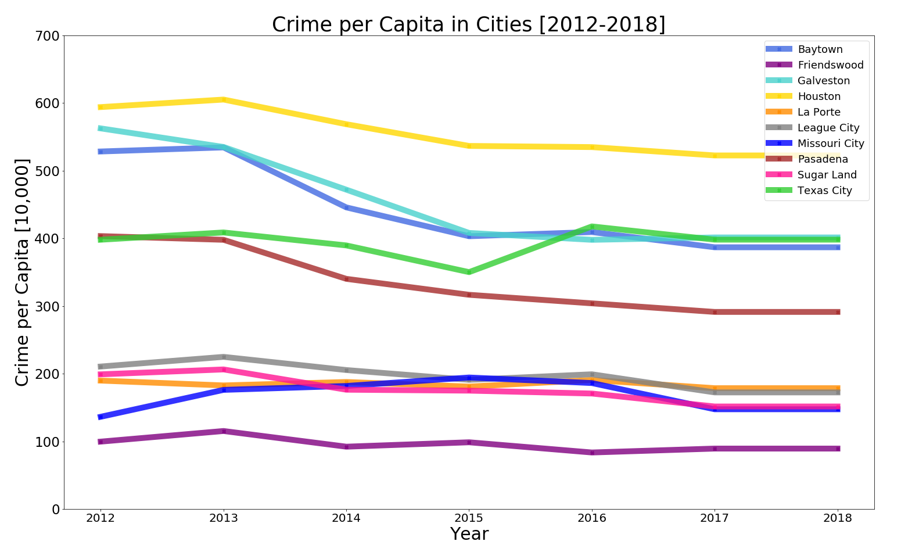

TOTAL CRIME PER CAPITA FOR EACH CITY
Notes:
The dataset exploits the unique crime drop that occurred in 2014. This allows us to take much broader perspective
on the relationship between crime and property values. We plot the yearly crime data in cities, this creates Pandas
series where the index is the year and values are the cities where the crime occurred in that year. We plot this yearly data
using matplotlib.
Crime rates have decreased about approximately 10 percent between 2016-2018.
Preliminary data indicates increase of average and median sales price in cities between 2016-2018.
Crime rates peaked around 2012, held steady until 2013, then decreased to 10 percent in 2014.

Slide 7
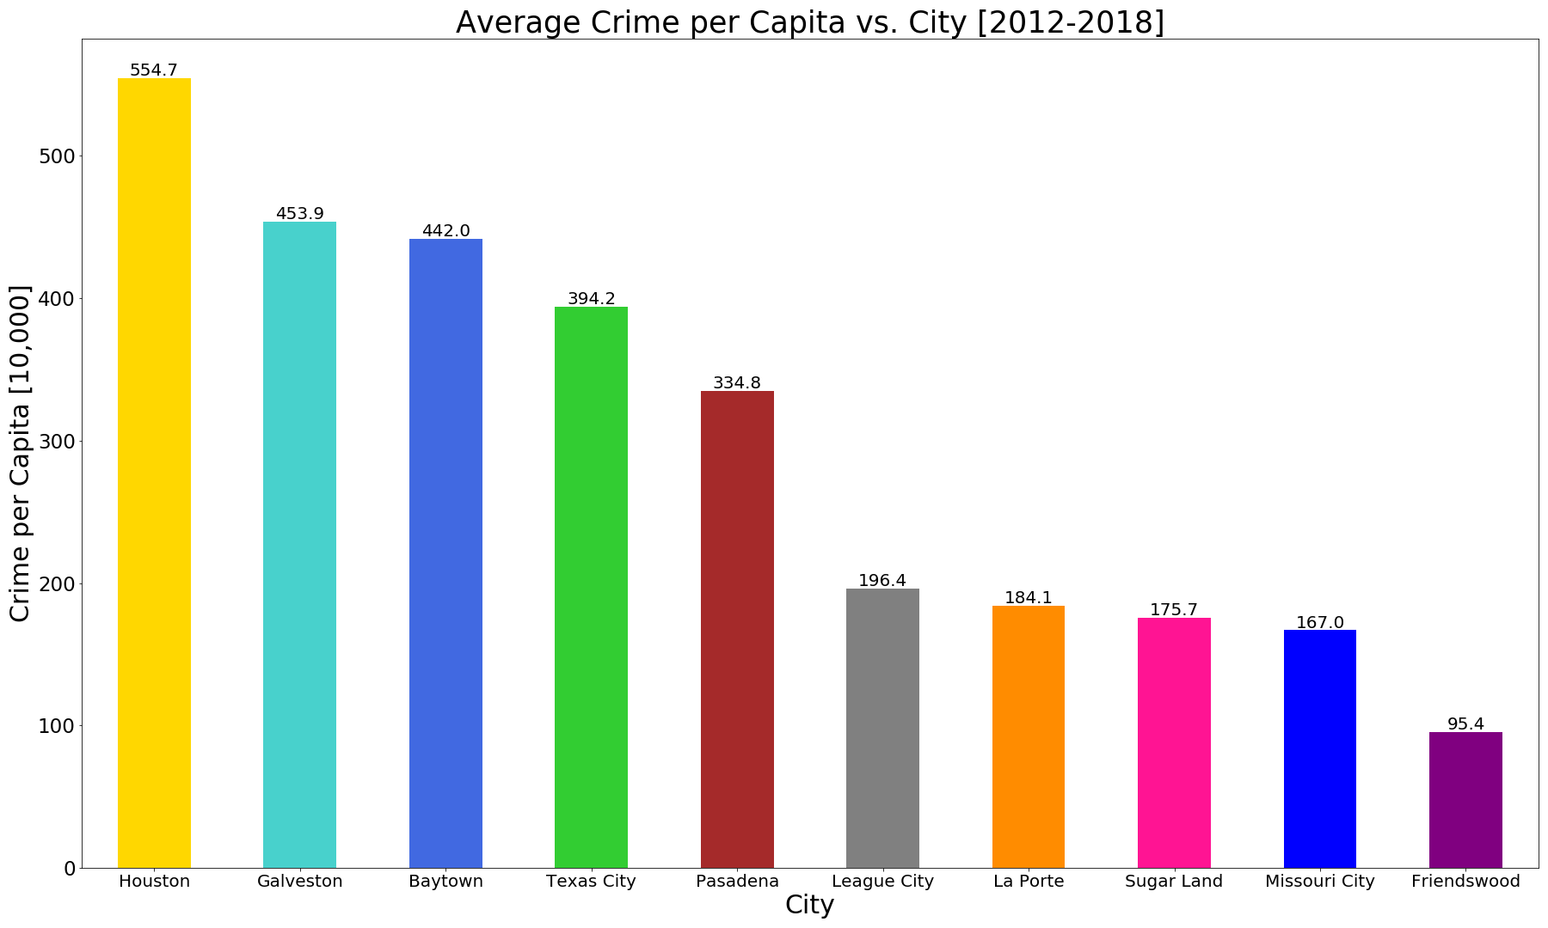

AVERAGE CRIME PER CAPITA VS. CITY
Notes:
The trend of yearly crime has been steadily decreasing around

Slide 8
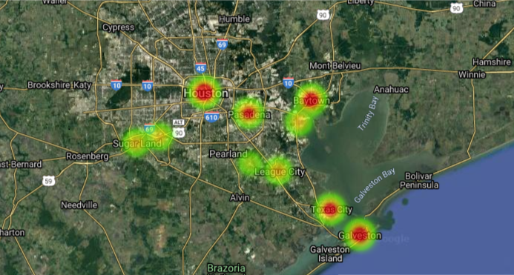
CRIME HEAT MAP
Highest Intensity
Lowest Intensity
Notes:
Residential burglaries and crime hot spots are illustrated in this map. Crime is not spread evenly, as it clumps in some
areas and is absent in others.

Slide 9
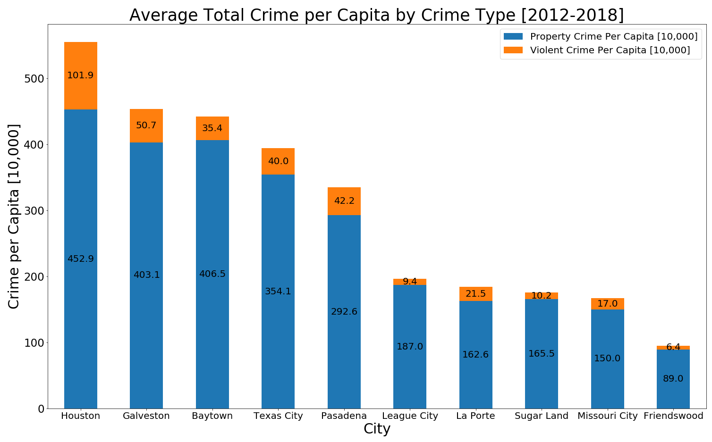
TOTAL CRIME AVG. PER CAPITA IN CITIES

Slide 10
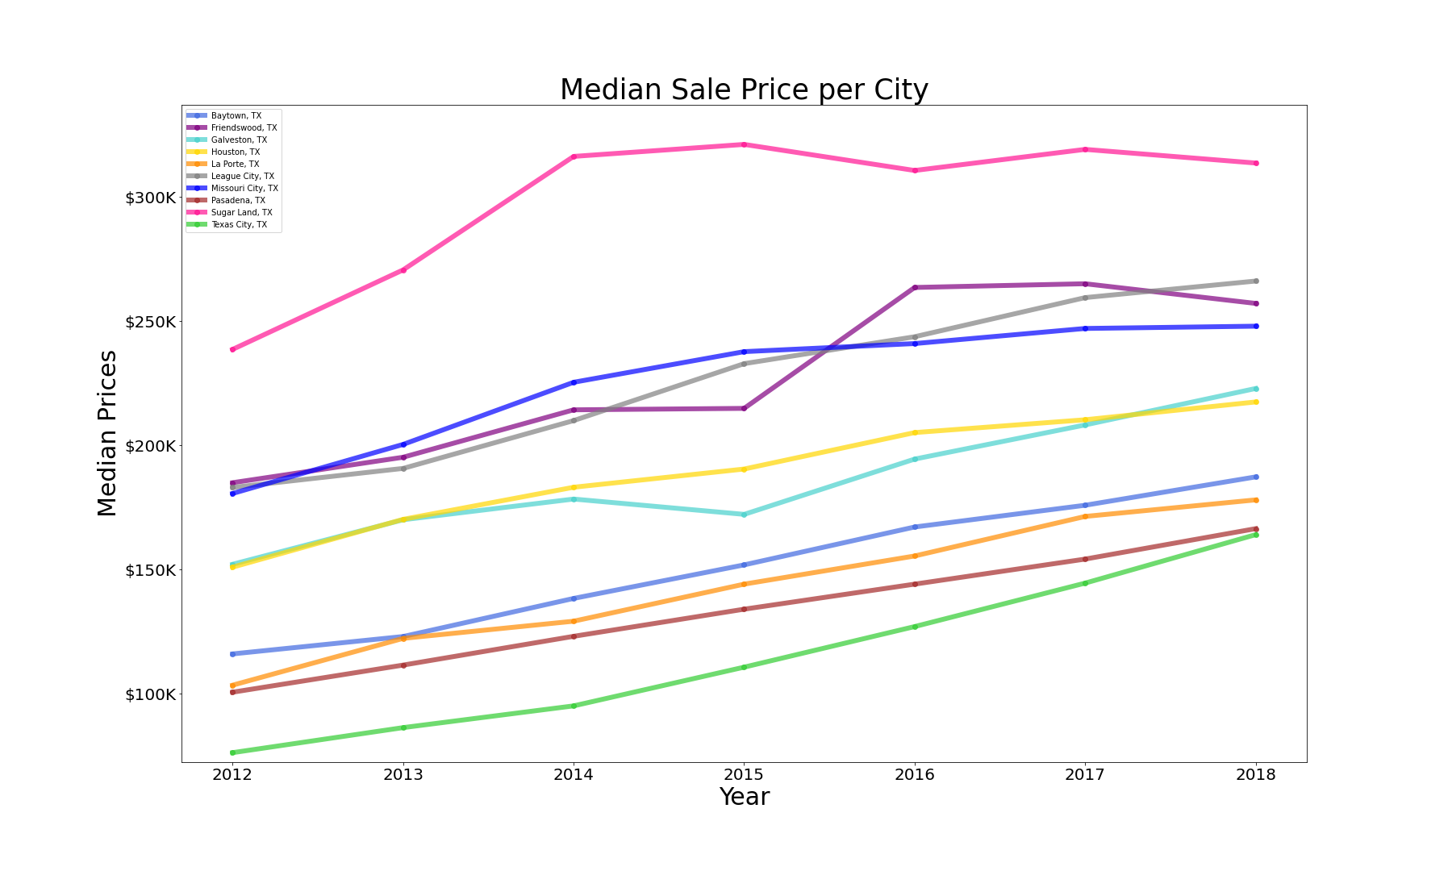

MEDIAN SALE PRICE PER CITY
Notes:
This graph shows a steady increase of house values from 2012 through 2018, and housing crisis in 2012.

Slide 11
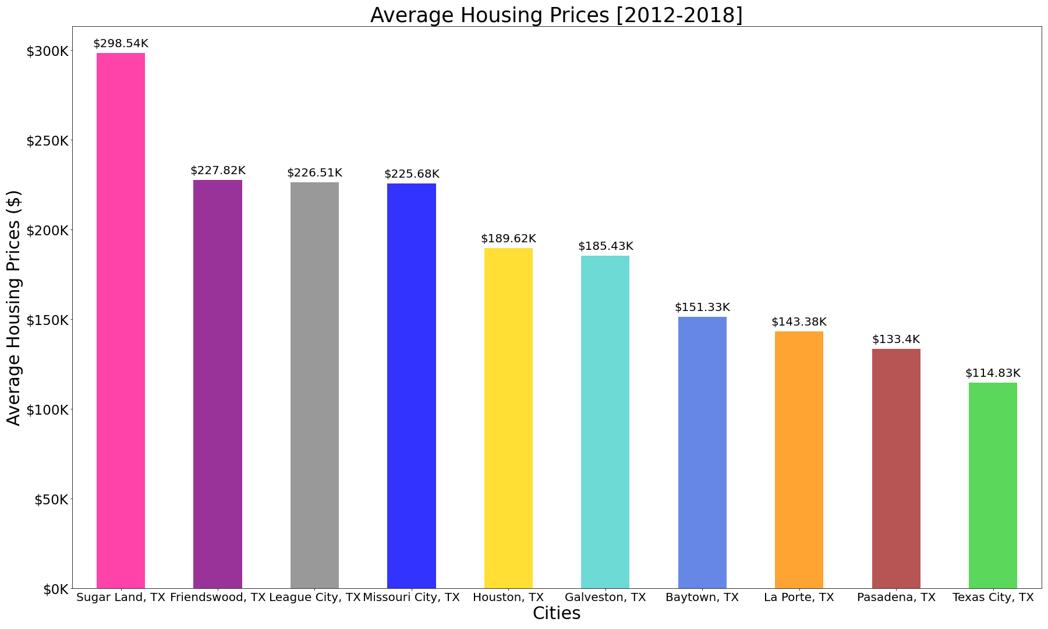

AVERAGE HOUSING PRICES
Notes:
For our analysis we want to exploit the variation in crime that occurs within cities from 2012-2018.
The proportion of crime in the area has a negative impact on the price. If the proportion of crime increases by one percentage point, prices are expected to drop by 1.5%.

Slide 12
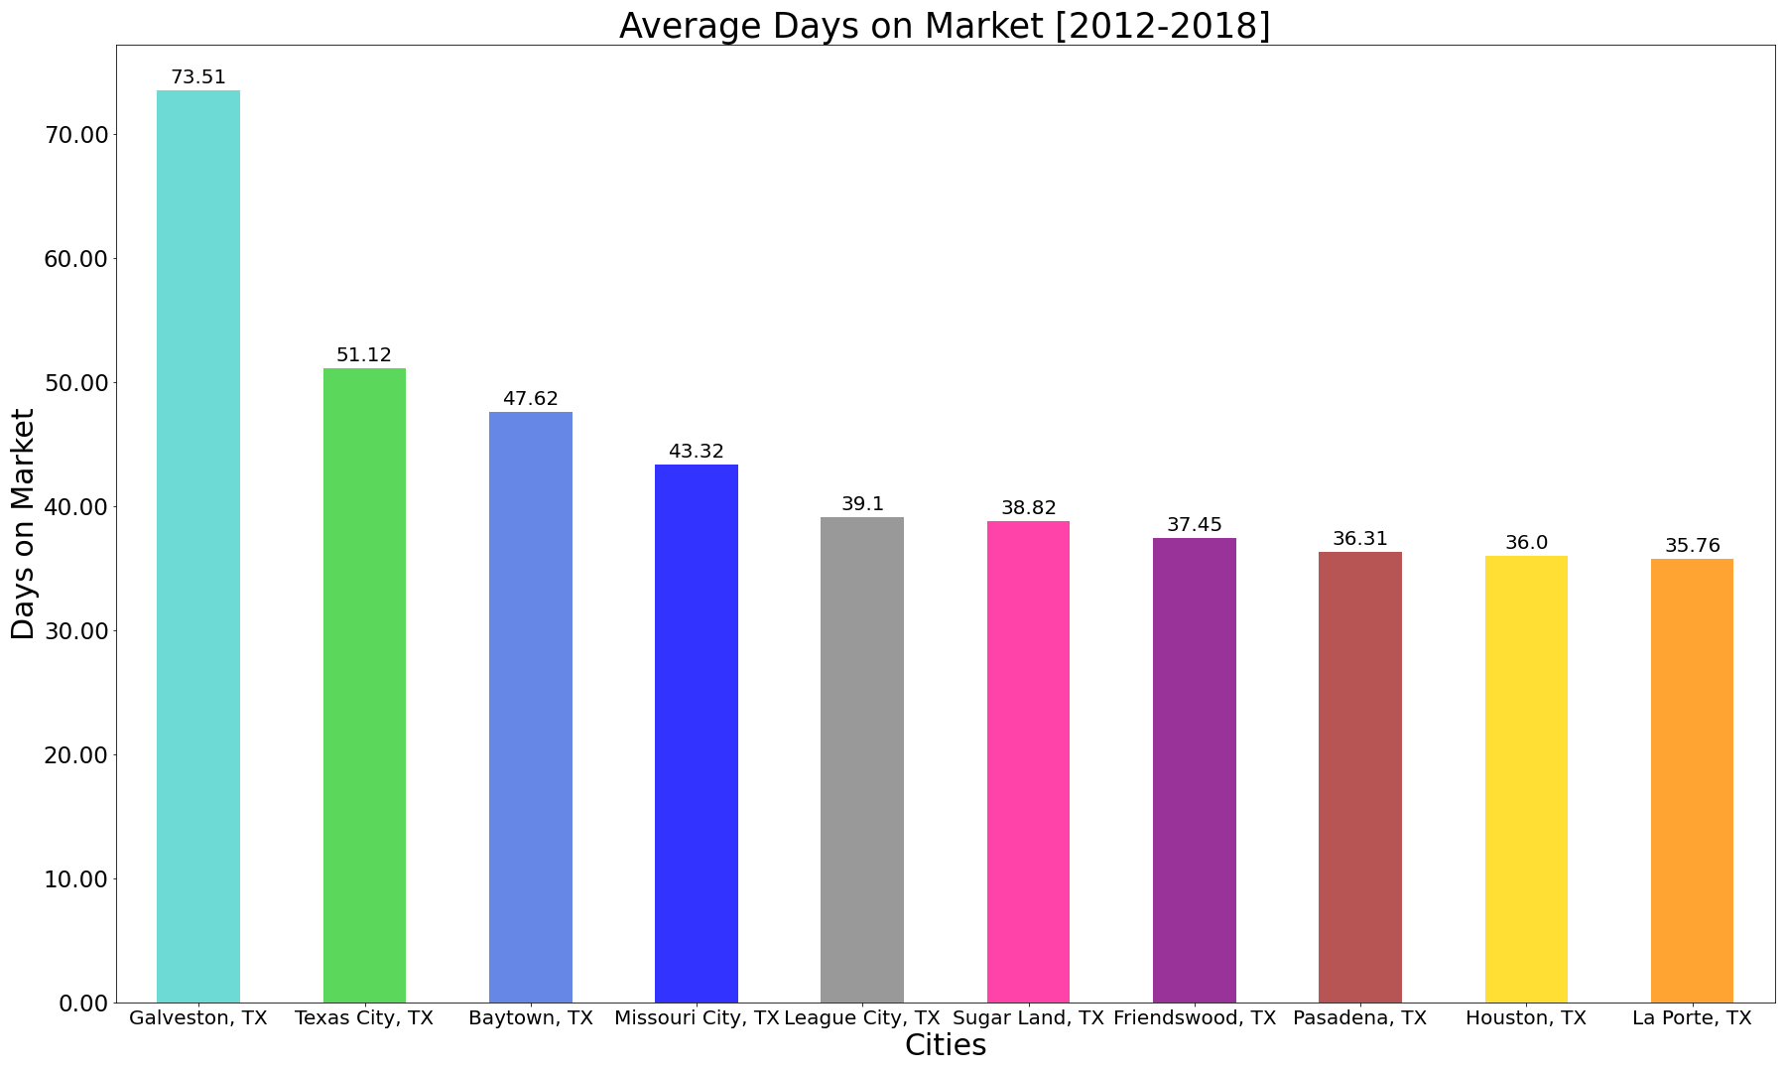

AVERAGE Days on Market
Notes:
For our analysis we want to exploit the variation in crime that occurs within cities from 2012-2018.
The proportion of crime in the area has a negative impact on the price. If the proportion of crime increases by one percentage point, prices are expected to drop by 1.5%.

Slide 13
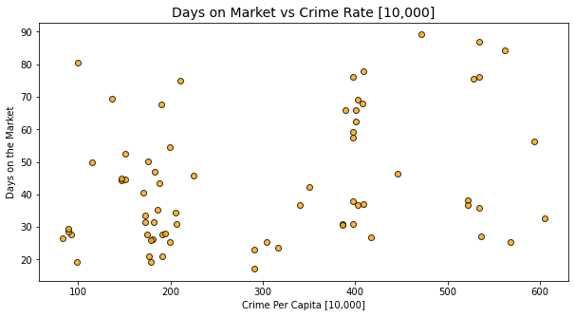
Days on Market vs Crime Rate
Should 10,000 be in the chart title or just in the X axis?
Notes:
The graph on the left shows the relationship between Crime rate and Property Value.
The above chart shows the probability of the crime rate in the housing market between the cities from 2012-2018.
To do this we combine Information from the Redfin Housing Data with a dataset from
UCR Publications | Federal Bureau of Investigation to produce measure of crime changes between 2012-2018.

Slide 14
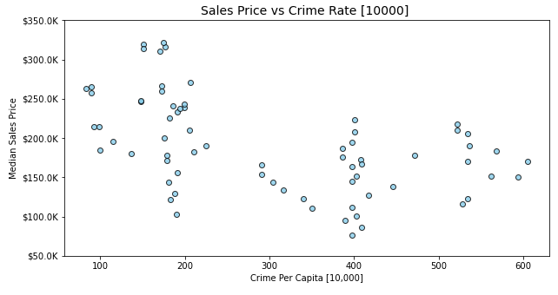
Sales Price vs Crime Rate
Should 10,000 be in the chart title or just in the X axis?
Notes:
The graph on the left shows the relationship between Crime rate and Property Value.
The above chart shows the probability of the crime rate in the housing market between the cities from 2012-2018.
To do this we combine Information from the Redfin Housing Data with a dataset from
UCR Publications | Federal Bureau of Investigation to produce measure of crime changes between 2012-2018.

Slide 15
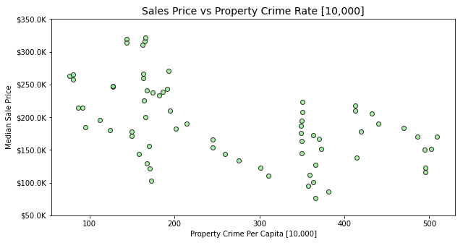
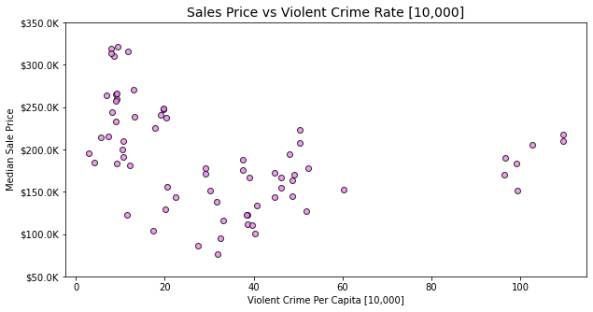
Sales Price vs Property Crime and Violent Crime
Should 10,000 be in the chart title or just in the X axis?
Notes:
The graph on the left shows the relationship between Crime rate and Property Value.
The above chart shows the probability of the crime rate in the housing market between the cities from 2012-2018.
To do this we combine Information from the Redfin Housing Data with a dataset from
UCR Publications | Federal Bureau of Investigation to produce measure of crime changes between 2012-2018.

Slide 16
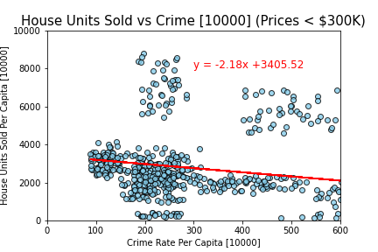
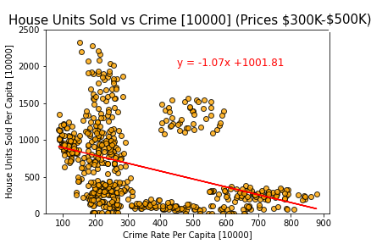
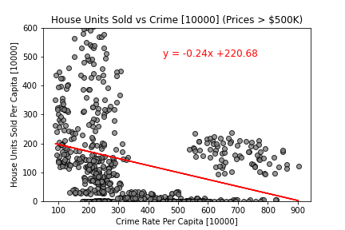
Housing Units Sold by Price vs Crime Rate
*Are chart titles all the same size?
*Should the Y axis be per capita? The housing bar charts are not per capita
*Consider displaying only 2 images for space – less than 300K and 300-500k
*Is this census data? If so, may want to clarify while discussing this slide in the presentation

Slide 17
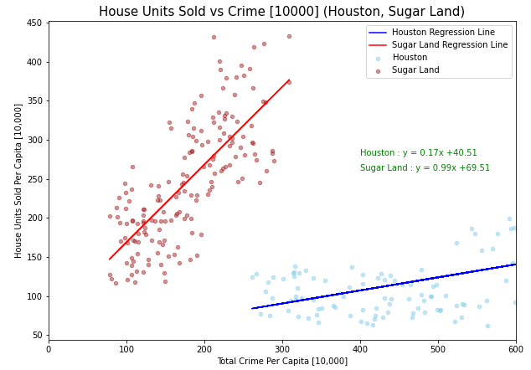
HOUSING UNITS SOLD vs CRIME RATE IN SUGAR LAND AND HOUSTON
*Should the Y axis be per capita? The housing bar charts are not per capita
Should [10,000], Houston, and Friendswood be in the chart title or just in the X axis and legend?

Slide 18
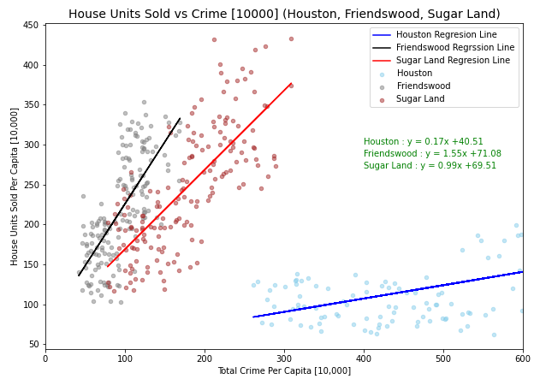
HOUSING UNITS SOLD vs CRIME RATE IN SUGAR LAND AND HOUSTON
*Should the Y axis be per capita? The housing bar charts are not per capita
Should [10,000], Houston, Friendswood, and Sugar Land be in the chart title or just in the X axis and legend?

Slide 19
SUMMARY
Need to update slide with latest summary details and wrap up info
This analysis takes the central locations of crime hot spots as its reference and assesses whether housing prices decline when relatively closer to these statistically significant crime concentrations.
The Houston metropolitan area is served by Extensive public transportation system, including metro train that connects Houston Downtown area with NRG Stadium area, which is known for higher crime rate.
Other cities are also exposed to a variety of amenities, such as plenty of buildings, lakes, shopping centers, which makes these cities the most desirable. We merged Housing market data with crime data to estimate valuation impact of total number of crime incidents in each city and the distance of crime location.
Per our analysis, the distance to the location, within the city have negative effect on housing values. Locations plays a significant role in the city housing valuation, where closer to crime locations lower housing values.
WHY DID WE PICK THESE CITIES. (POPULATION)
Notes:
Crime concentrations are found in the metropolitan area.

Slide 20

THANK YOU
2
+
2
+

